Slide 1
ORCHESTRATION OF CONTAINERS USING ANSIBLE
Guide: Harshitha K P
Mohan Kumar J 181041008
SOIS Suman Banakar
181041012

Slide 2
Agenda
Introduction
Objective
System Architecture
Phases of Recommendation Process
Snapshots
References

Slide 3
Introduction
Docker containers share the kernel of the underlying container host, however they don’t need to run a full operating system. Rather, the software and dependencies are wrapped in a container that run on top of the container host.
Ansible is an automation tool that aims to ease tasks like configuration management, application deployment and intra-service orchestration. It has a built-in Docker module that integrates with Docker for container management.

Slide 4
Objective
The main objective of this project is to run Docker containers and manage the containers on nodes through Ansible from host.

Slide 5
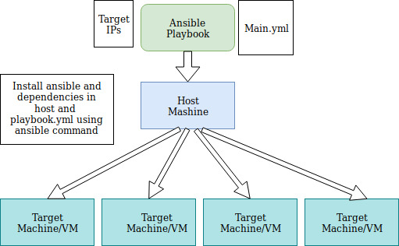
System Architecture

Slide 6
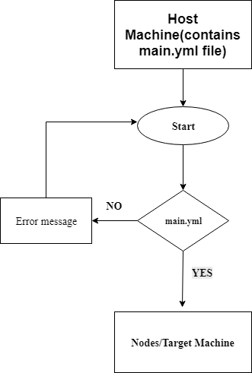
Phases of Recommended Process

Slide 7
Methodology:
Ansible on Linux
Step 1 — Build a docker image with Dockerfile
Create a directory on the workstation and a Dockerfile within the created directory
Step 2 — Edit inventory file
Inventory file contains IP addresses or domain names where we want deploy container. Add this file in your project

Slide 8
Step 3 — Edit Ansible playbook
docker_project/
main.yml
hosts
docker/
Dockerfile
Step 4 — Run the playbook
$ansible-playbook -i ~/hosts main.yml --ask-become-pass
–-ask-sudo-pass --ask-pass

Slide 9
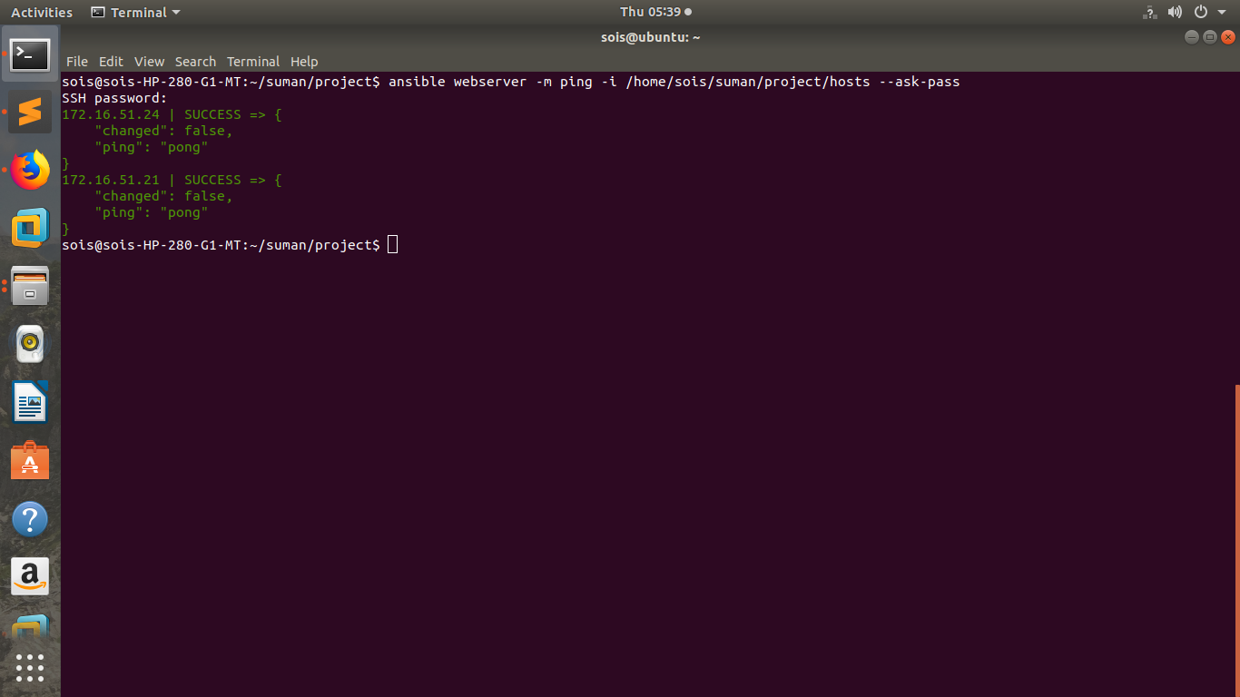
Snapshots-Ping nodes through ansible

Slide 10
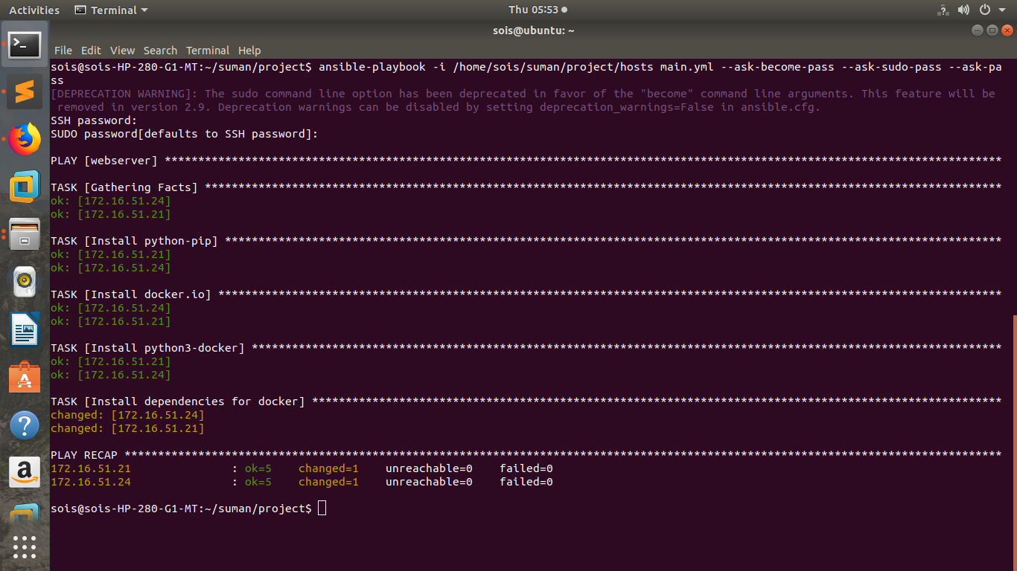
Snapshots
Install Docker and dependencies

Slide 11
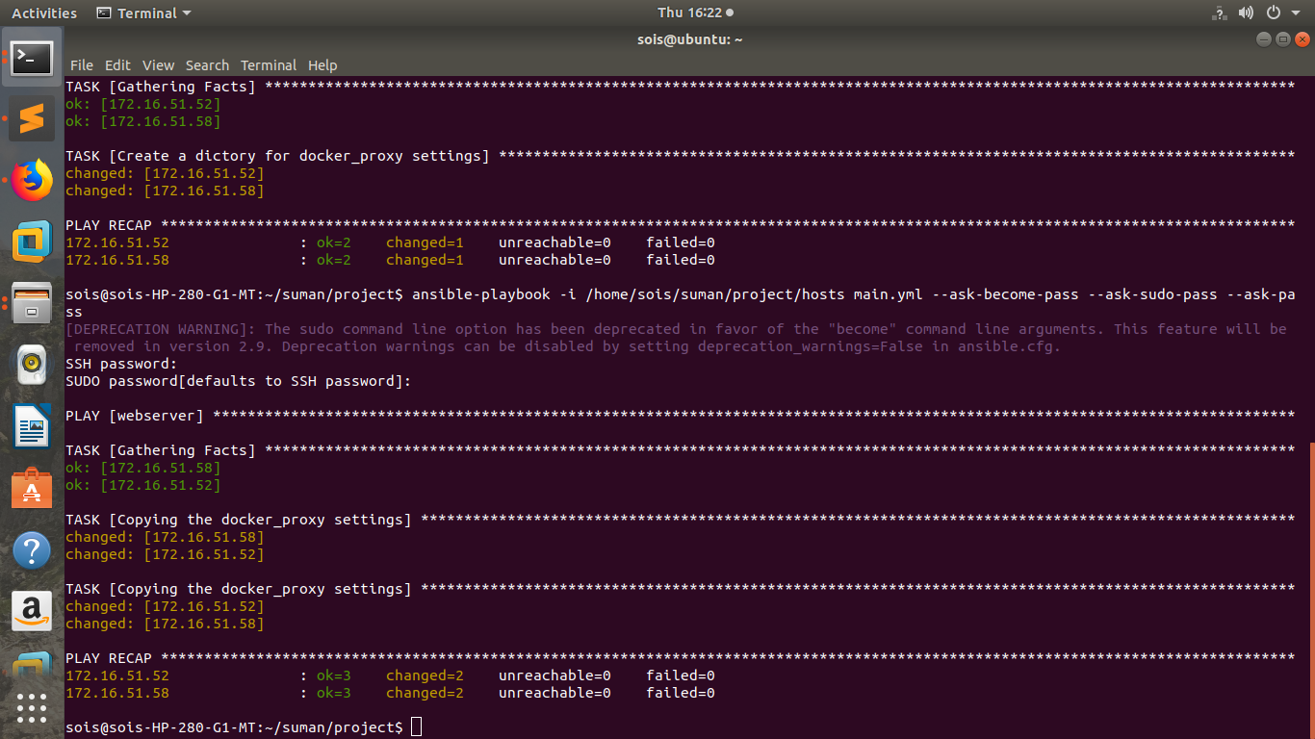
Creating directory for proxy settings and copying proxy files:

Slide 12
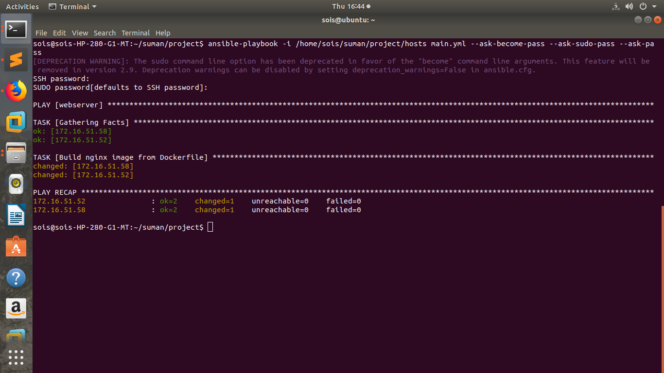
Snapshots
Build Nginx image from Dockerfile

Slide 13
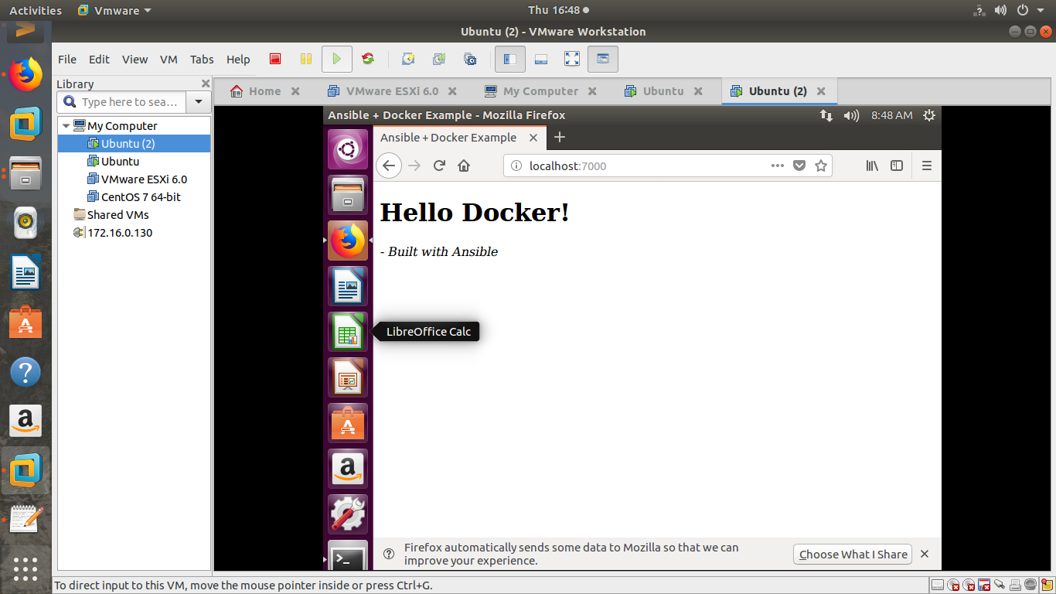
Snapshots
Resultant container

Slide 14
References
www.docker.com
www.Hub.docker.com
https://www.codementor.io/mamytianarakotomalala/how-to-deploy-docker-container-with-ansible-on-debian-8-mavm48kw0
https://docs.ansible.com/ansible/2.5/modules/docker_module.html
Carlos de Alfonso ∗, Amanda Calatrava, Germán Moltó[1]
Orchestration of containerized microservices for IIOT using docker
Jo˜ao Rufino∗, Muhammad Alam∗, Joaquim Ferreira∗,‡, Abdur Rehman†, Kim Fung Tsang∗∗
∗ Instituto de Telecomunicac¸ ˜oes, Campus Universit´ario de Santiago, 3810-193 Aveiro, Portugal ESTGA - Universidade de Aveiro, 3754-909 A´ gueda, Portugal
Joshua Higgins(B), Violeta Holmes, and Colin Venters
The University of Huddersfield, Queensgate, Huddersfield, UK
{joshua.higgins,v.holmes,c.venters}@hud.ac.uk[3]
2015 IEEE International Conference on Cloud Engineering[4]

Slide 15
Thank you

